Slide 1
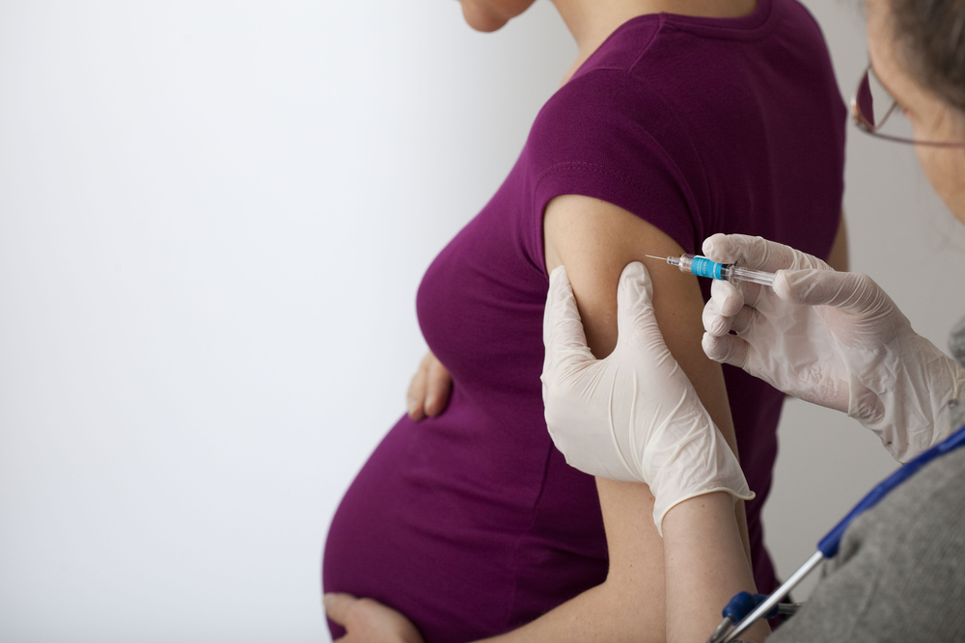
Solution to HW05

Slide 2
Background
Doctors examined 485 women who had miscarriages and noted some had back-to-back flu shots
Note that is not a simple random sample of those who had back-to-back flu shots
From the original paper: “This study does not and cannot establish a causal relationship between repeated influenza vaccination and SAB [influenza], but further research is warranted.”
Q1: Correct H₀: rate of back-to-back flu shots is the same in the population …

Slide 3
Background
Doctors examined 485 women who had miscarriages and noted some had back-to-back flu shots
Student question: “Isn’t the question of whether vaccine causes miscarriage the more interesting question?”
Yes, it is … but we can’t answer that question, since we don’t have a simple random sample of people who had back-to-back flu shots
Analogy: does drinking water cause car crashes? Data were collected from 10 auto accidents … in all cases, the driver had had water in the previous 24 hours …

Slide 4
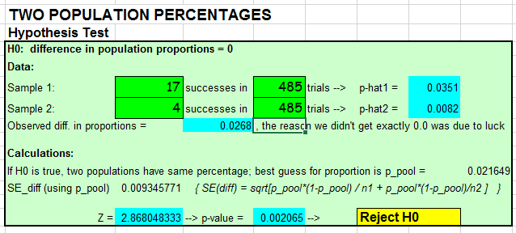
Q2: p-value: between 0.001 and 0.005

Slide 5
Q3: women with miscarriages are more likely to have back to back flu shots
Note that factors as to why those women had more miscarriages; e.g., maybe women at high risk of miscarriage want back-to-back shots
CDC: “It is possible that women who have an increased risk for miscarriage might also be more likely to have received influenza vaccine. These conditions could have made the women more likely to miscarry.”

Slide 6
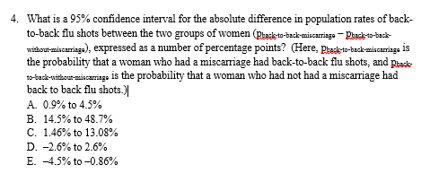
[badly worded … everyone gets credit]
INTENT of Q4: difference of two population percentages

Slide 7
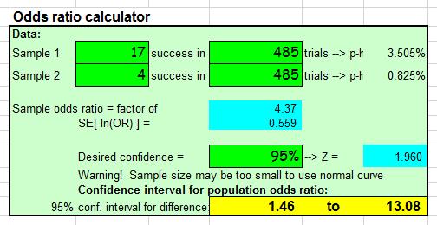
Q5: 95% CI for odds ratio:
Use calculator

Slide 8
Q6: can not be done, the 485 women with miscarriage not a simple random sample
“The study did not estimate risk of miscarriage after influenza vaccination … the findings cannot be used to estimate the probability of miscarriages for pregnant women who received an H1N1-containing flu vaccinations two years in a row.”
https://www.cdc.gov/flu/professionals/vaccination/vaccination-possible-safety-signal.html
Reminder: analogy of water and crashes

Slide 9
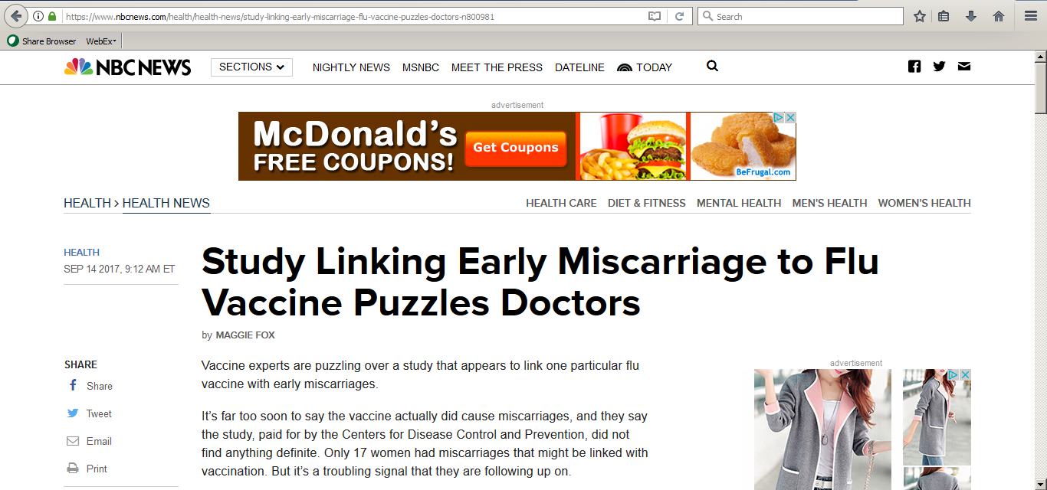
“We don’t want people to panic over this headline. Get your flu shot. It’s safe,” said Dr. Laura Riley, an obstetrician at Massachusetts General Hospital and Harvard Medical School.

Slide 10

“Do colleges and universities have a positive effect on the way things are going in the country?”

Slide 11
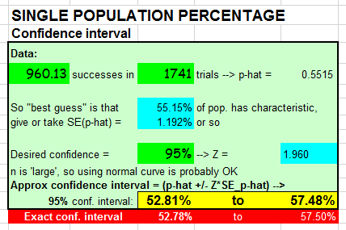
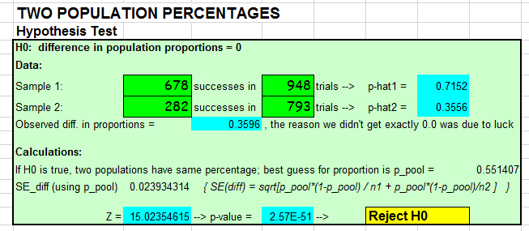
Q7: 95% CI for all adults: (B)
Q8: p = 10^{–51} (A)

Slide 12
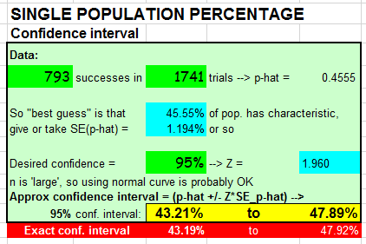
Q9: 95% CI for percentage of adults who are Republican: (B)
Q10: given p = 0.16
→ EV = 0.16n, SE = sqrt(n*0.16*0.84)
→ 5th percentile = EV – 1.645*SE
→ want 0.16n – 1.645*sqrt(n*0.16*0.84) > 499.5
→ n = 3339 (B)
(Check: =1-BINOMDIST(499,3339,0.16,TRUE) = 0.9505)

Slide 13
Remark about final exam
Date: Tuesday, December 12th
4:30 to 6:30pm or 7:00 to 9:00pm
Format (tentative)
1st hour: no laptops, closed book, basic calculations / understanding (e.g. homework)
2nd hour: laptops allowed (but no Internet), data analysis (e.g. project)
(Format subject to change)

